Slide 1

Mini Project:
Expense Tracker
Subject: Computer Programming – II
Branch: - IT (4th Sem)
Subject Code: - IT413
Submitted To:
Dr Neera Lal
Assistant Professor
Submitted By:
Deepak Sahu(0101IT231081)
Adnan Khan(0101IT243D01)

Slide 2




Project Objective and Scope
Empower Users
Intuitive Interface
To provide a straightforward tool for easy personal finance management.
Design a simple, user-friendly interface for quick and efficient input of financial data.
Dynamic Updates
Browser-Based
Ensure real-time display of financial status, including income, expenses, and overall balance.
Data is stored locally in the browser (session/local storage), eliminating the need for a backend.

Slide 3

Technology Stack
HTML5: The foundational markup language used for structuring the web page and creating interactive forms.
CSS3: Utilized for styling the application, ensuring a responsive, clean, and visually appealing user interface.
JavaScript: Powers the dynamic functionality, handling user interactions, data manipulation, and real-time updates without external libraries.
Bootstrap: In some iterations, Bootstrap was explored for rapid prototyping and consistent styling.

Slide 4
User Interface Design
1
2
Input Form
Amount Logic
A clear section with fields for entering transaction descriptions and amounts.
The sign of the amount entered determines if it's an income (+) or an expense (-).
3
4
Display Sections
Transaction List
Dedicated areas for Current Balance, Total Income, and Total Expenses, providing a quick overview.
A dynamically updated list of all transactions, complete with delete buttons for each entry.

Slide 5
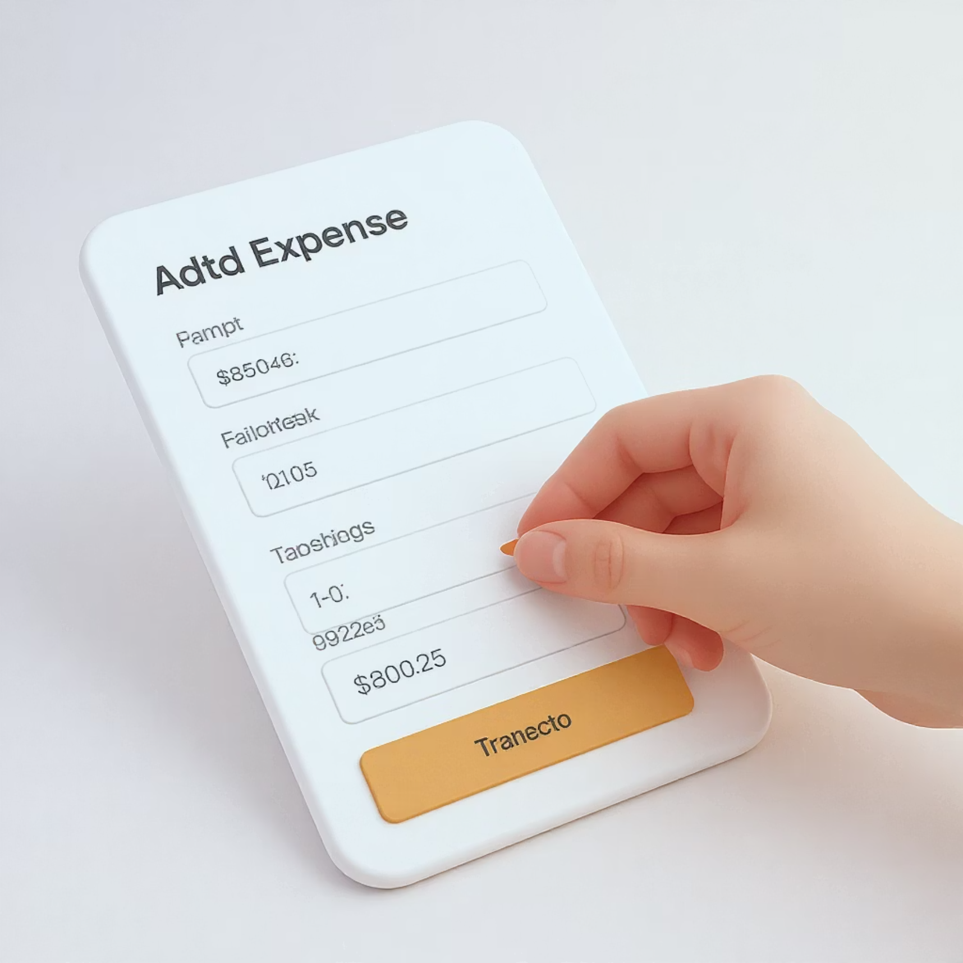
Adding Transactions
The process of adding a new transaction is streamlined for user convenience.
1
User Input
Users enter a description and the corresponding numerical amount into designated fields.
2
Input Validation
JavaScript validates the input to ensure fields are not empty and the amount is numeric.
3
Object Creation
A new transaction object is created, encapsulating the description and amount, and stored within a JavaScript array.
4
UI Update
The user interface instantly reflects the new entry, and all financial totals (balance, income, expenses) are recalculated in real-time.

Slide 6




Data Handling and Persistence
Effective data management is crucial for a seamless user experience:
JavaScript Array Storage
All transaction data is primarily stored within a dynamic JavaScript array, allowing for efficient in-memory manipulation.
localStorage Persistence
For data to persist across browser sessions, transactions can be saved to and loaded from localStorage, ensuring user data is retained.
DOM Manipulation
The user interface is dynamically updated by manipulating the Document Object Model (DOM) to render the transaction list and financial summaries.
Event Listeners
Robust event listeners are implemented to capture and respond to user interactions, such as form submissions and clicks on delete/edit buttons.

Slide 7

Challenges and Learning Outcomes
State Management: Efficiently managing the application's state and ensuring the UI consistently reflects the underlying data.
Input Validation: Implementing robust validation and clear error handling for user inputs to prevent malformed data.
UI Responsiveness: Striking a balance between creating a highly responsive user interface and maintaining concise, simple code.
Practical JavaScript Skills: Gaining hands-on experience with JavaScript event handling, DOM manipulation, and dynamic content rendering.

Slide 8
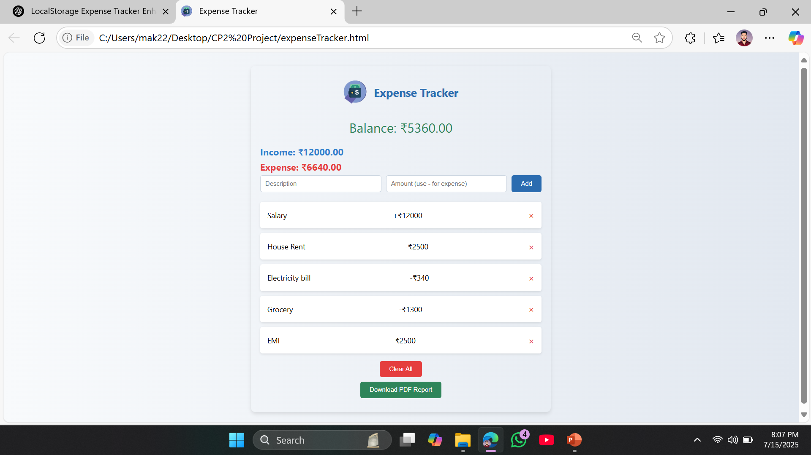
Project Screenshots:

Slide 9
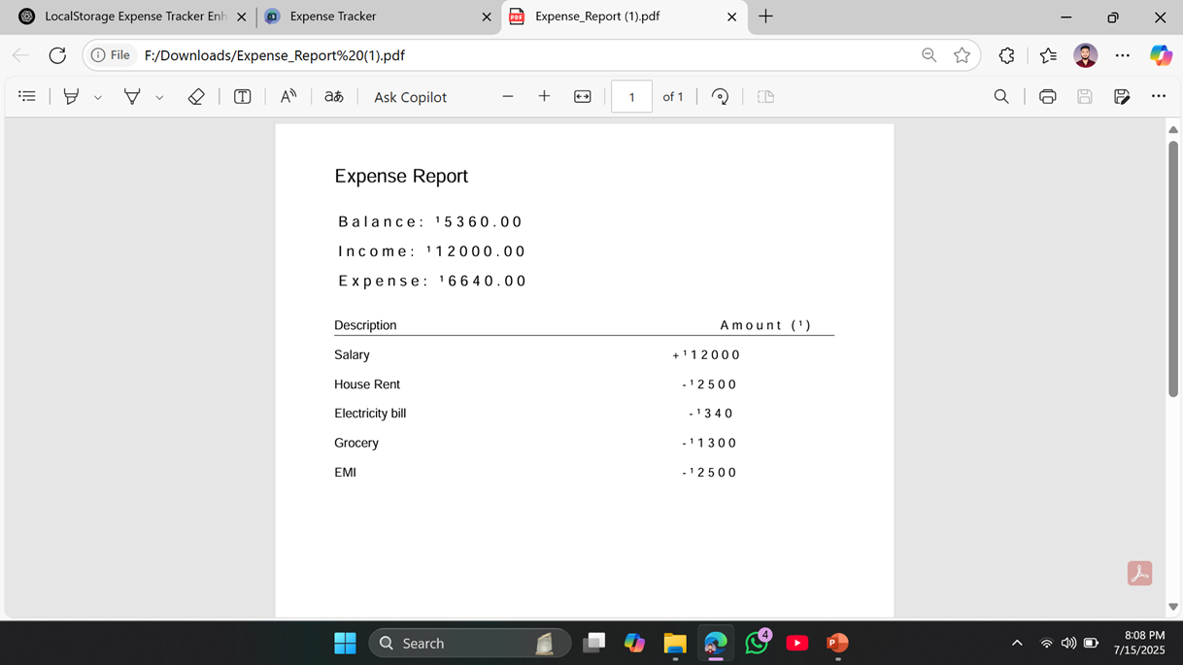
Project Screenshots:

